Slide 1
Enhancing Canada's Innovation Landscape: A Data-Driven Consultancy Approach
Group 10: Chenchen Zhang
Ningxin Cynthia Li
Yifei Ren
Weihong Gan
Yanbing Li
Bohan Ruan
Tian Jin

Slide 2

Motivation
Analyze over 20 Innovation Reports
Propose Potential policies to Boost Innovation in Canada
Present Practical Steps derived from the Policies

Slide 3
Table of contents
01
02
03
04
Infrastructure
Data Analysis and Innovation Measurement
Based on GII 2023 and Reports from 7 Countries
Policies and Practical Strategies for Infrastructure
Business Sophistication
Knowledge and Technology Output
Policies and Practical Strategies for Business Sophistication
Policies and Practical Strategies for Business and Technology Output

Slide 4
01
Data Analysis and Innovation Measurement
Based on GII 2023 and Reports from 7 Countries

Slide 5
Data Source
GII 2023 and Innovation Reports from 7 Countries
Global Innovation Index (GII) 2023 | Includes 80 Indicators about Innovation and Ranked 132 Countries Innovation Performance
Canada | 8 Reports that Cover Canada’s Innovation Strategy, Budget for 2017 and MITACTS¹
USA | 3 Reports that Cover USA’s Innovative Technology Strategy, Sustainable Development Planning
UK | 5 Reports that Cover UK’s Science Techology Framework and Innovation Strategy
Korea | Korea’s Strategy for Government Innovation
Japan | Integrated Innovation Strategy 2022
Singapore | The National Innovation of Singapore
Switzerland | Switzerland GLobal Enterprise
1. MITACTS: Mathematics of Informtion Technology and Complex Systems founded by Canadian Mathematicians in 1999

Slide 6

Data Analysis Protocol
Convert the PDF into Words and Remove Special Characters and Stopwords
K-means Clustering
Data Cleaning
Clustering
Text Analysis
Calculate the Top 40 Most Frequent Works
Innovation Measurments
Conclude Innovation Measurements based on Clustring Results

Slide 7
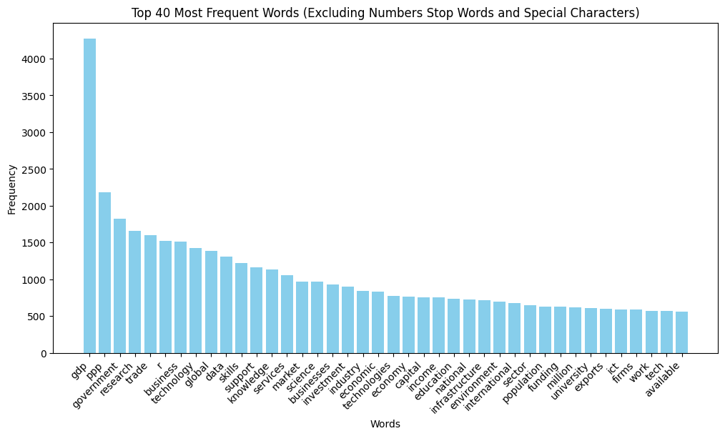
Top 40 Most Frequent Words
GDP
PPP
Knowledge
Technology
Business
Infrastructure

Slide 8
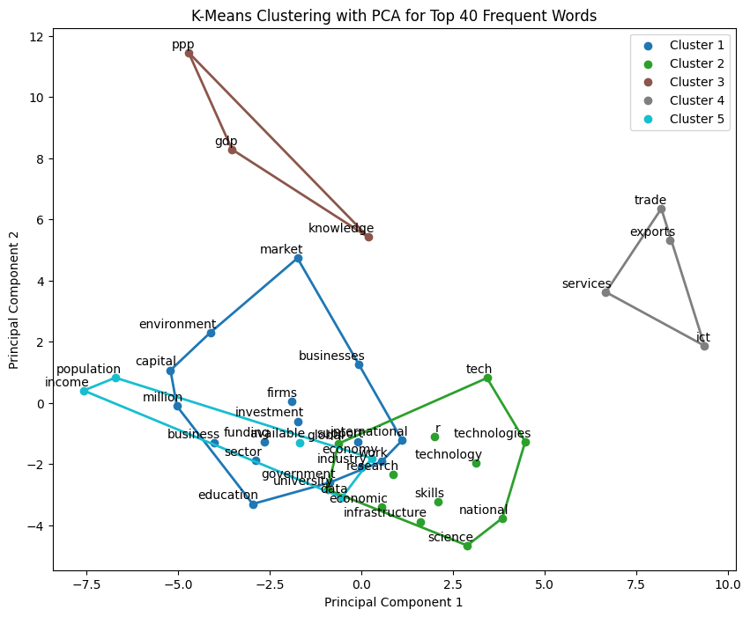
Clustering
Knowledge and Technology Outputs
(focuses on knowledge creation, impact, and diffusion, measured in units such as ”%GDP” and ”bn PPP$ GDP”)
Knowledge
GDP
PPP
Business Sophistication
(evaluates a country’s performance in supporting knowledge-based businesses, such as tech-related startups, through actions like investment provision)
Business
Firms
Investment
Infrastructure
(evaluates a country’s infrastructure based on Information, Communications Technology and General Infrastructure and ect.)
Technology
Infrastructure

Slide 9
Proposal for Canada’s Innovation Development
Innovation
Infrastructure
Business Sophistication
Knowledge and Technology Output

Slide 10
02
Infrastructure
Policies and Practical Strategies for Infrastructure

Slide 11
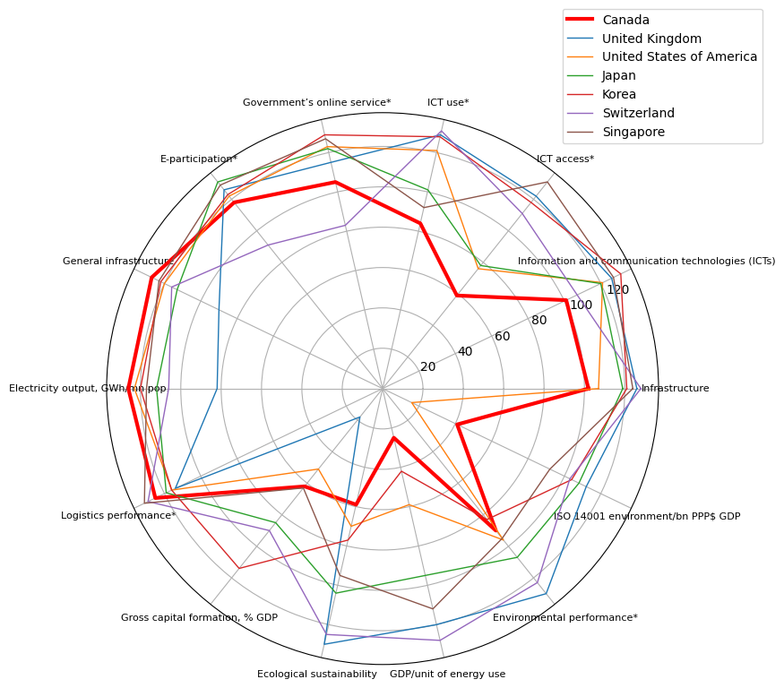
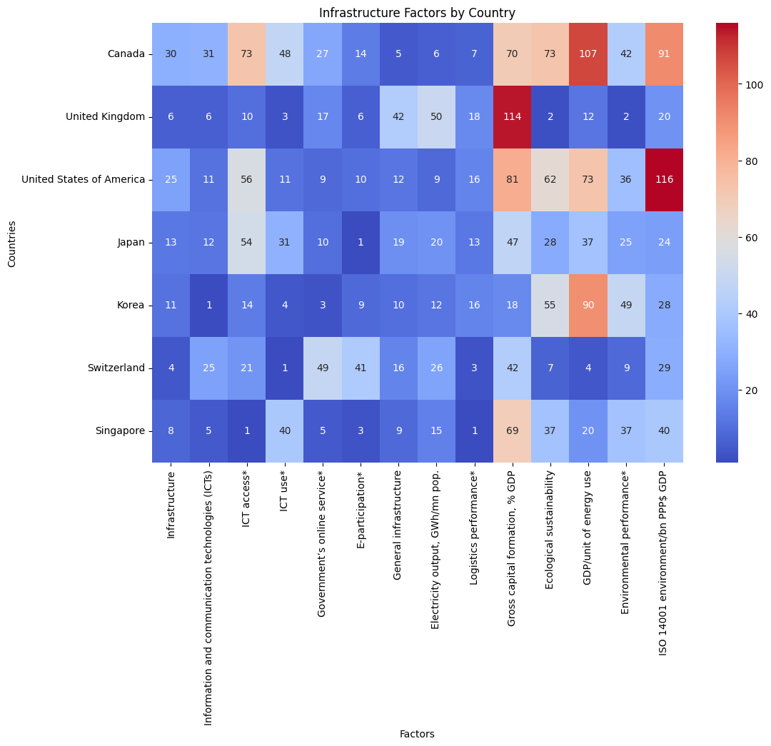
Infrastructural Factors

Slide 12
Ecological Sustainability Development
GDP/Unit of Energy Use
ISO 14001 Standard
GDP/unit of energy use is an indicator of energy productivity. A higher GDP/unit of energy use means less energy wasted or more efficient energy usage.
ISO 14001 is an internationally agreed standard that sets out the requirements for an environmental management system. Companies and organization could certified it.

Slide 13
GDP/Unit of Energy Use
Feasibility
01
Phase-out of nuclear energy
02
Reduce energy consumption, restrict energy efficiency standard.
Switzerland
03
EnergieSchweiz: platform for energy efficiency and renewable energy
04
Gradually liberalized the electricity market

Slide 14
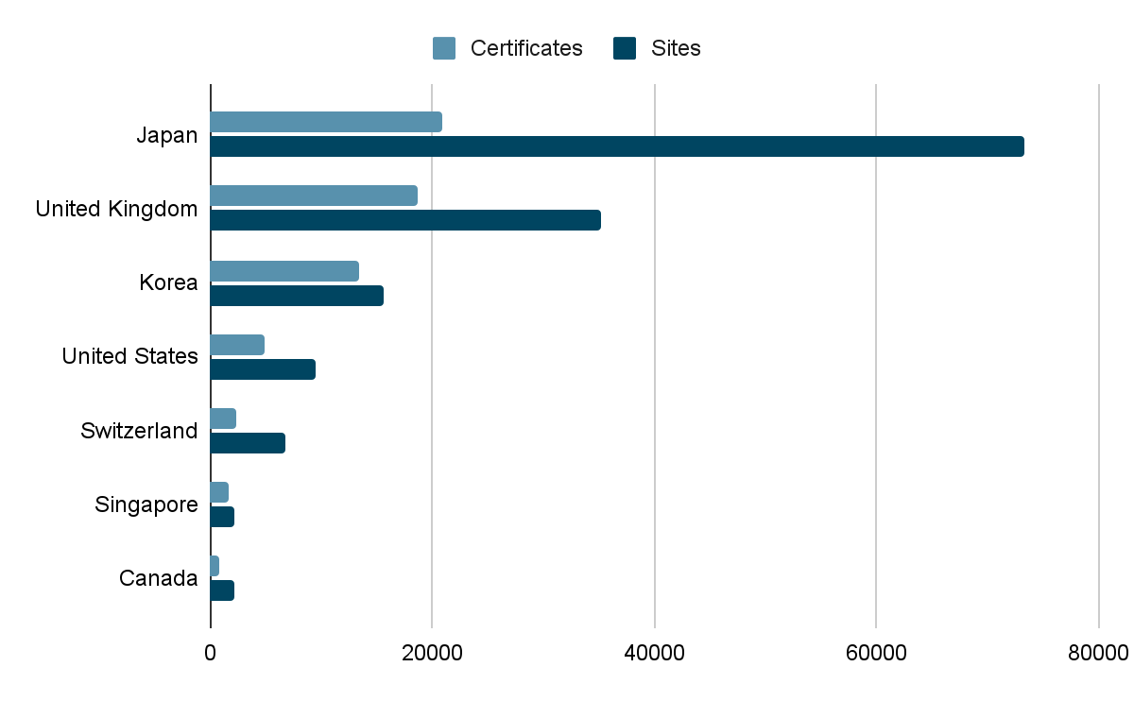
ISO 14001 Survey in 2022
Legend
Certificates
Sites
Number of valid certificates by country
Number of office sites covered by their certificates
In Canada, only 845 entities registered under ISO 14001, ranked 91st around the world.

Slide 15
Policies and Practical Strategies
Strengthen Government Programs
Enhance Industry-Academic Collaboration
Public Relations Strategy
Energy Efficiency Standard
Partnerships for Research and Innovation
Nationwide Awareness Campaign
Establish Federal Platform
Tax Incentives and CCUS Technology Development
Engagement and Education Initiatives on Social Media
Mentorship and Legislation for ISO 14001
Example PR Poster in Next Page

Slide 16

Example Social Media Promotion Poster

Slide 17
03
Business Sophistication
Policies and Practical Strategies for Business Sophistication

Slide 18
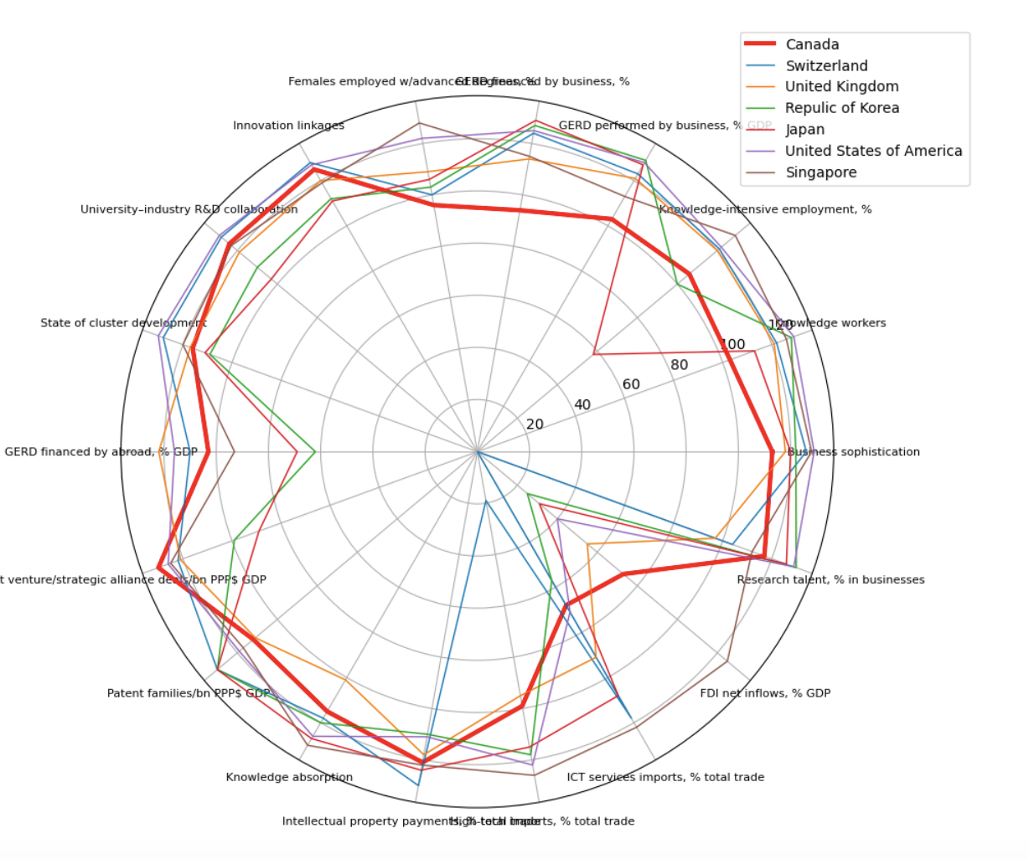
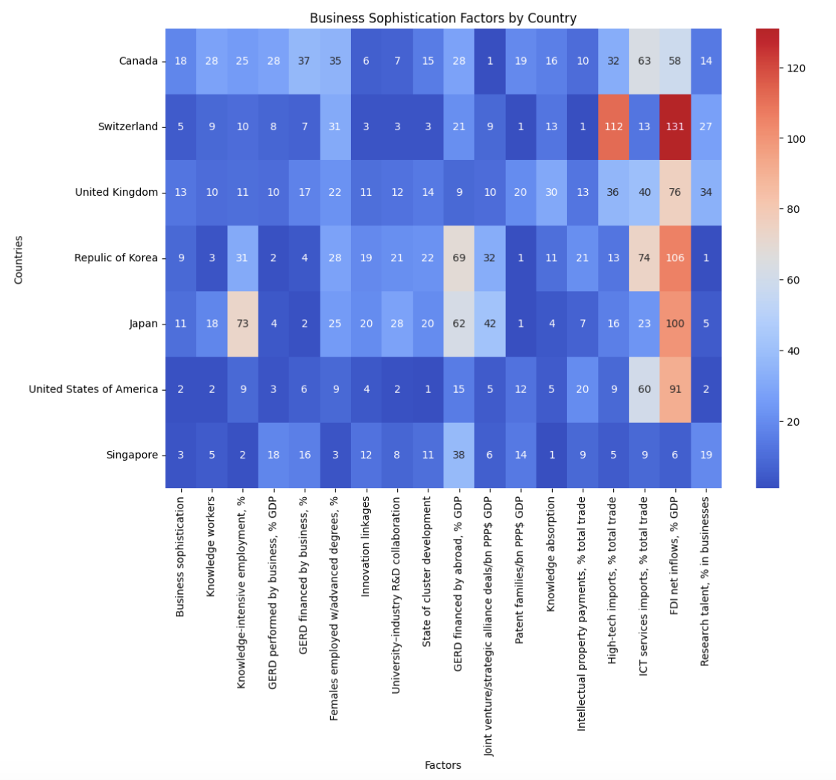
Business Sophistication Factors
GERD financed by business

Slide 19
Enhanced R&D Investment
34.291%
67.908%
Singapore Model
USA Model
Characterized by substantial government funding
Developed a collaborative ecosystem with public research centers and industry partnerships
Driven predominantly by private sector investment
underscores the pivotal role of private sector funding in driving innovation

Slide 20
Enhancing Canada’s GERD Policy
Fostering Innovation and Commerical Success
Boosting Govt. R&D Support in Emerging Tech
Boosting Private Investment via R&D Tax Reform
Enhanced R&D Grant Progeam
Sector-Specific Focus
Increased Tax Credits for R&D Expenditures
Simplified Tax Credit Claim Process

Slide 21
25%
30%
Anticipated Outcomes and Impact Measurement
increase in funded startups by the end of 2025
rise in R&D spending by private firm

Slide 22
04
Knowledge & Technology Outupts
Policies and Practical Strategies for Knowledge and Technology Outputs

Slide 23
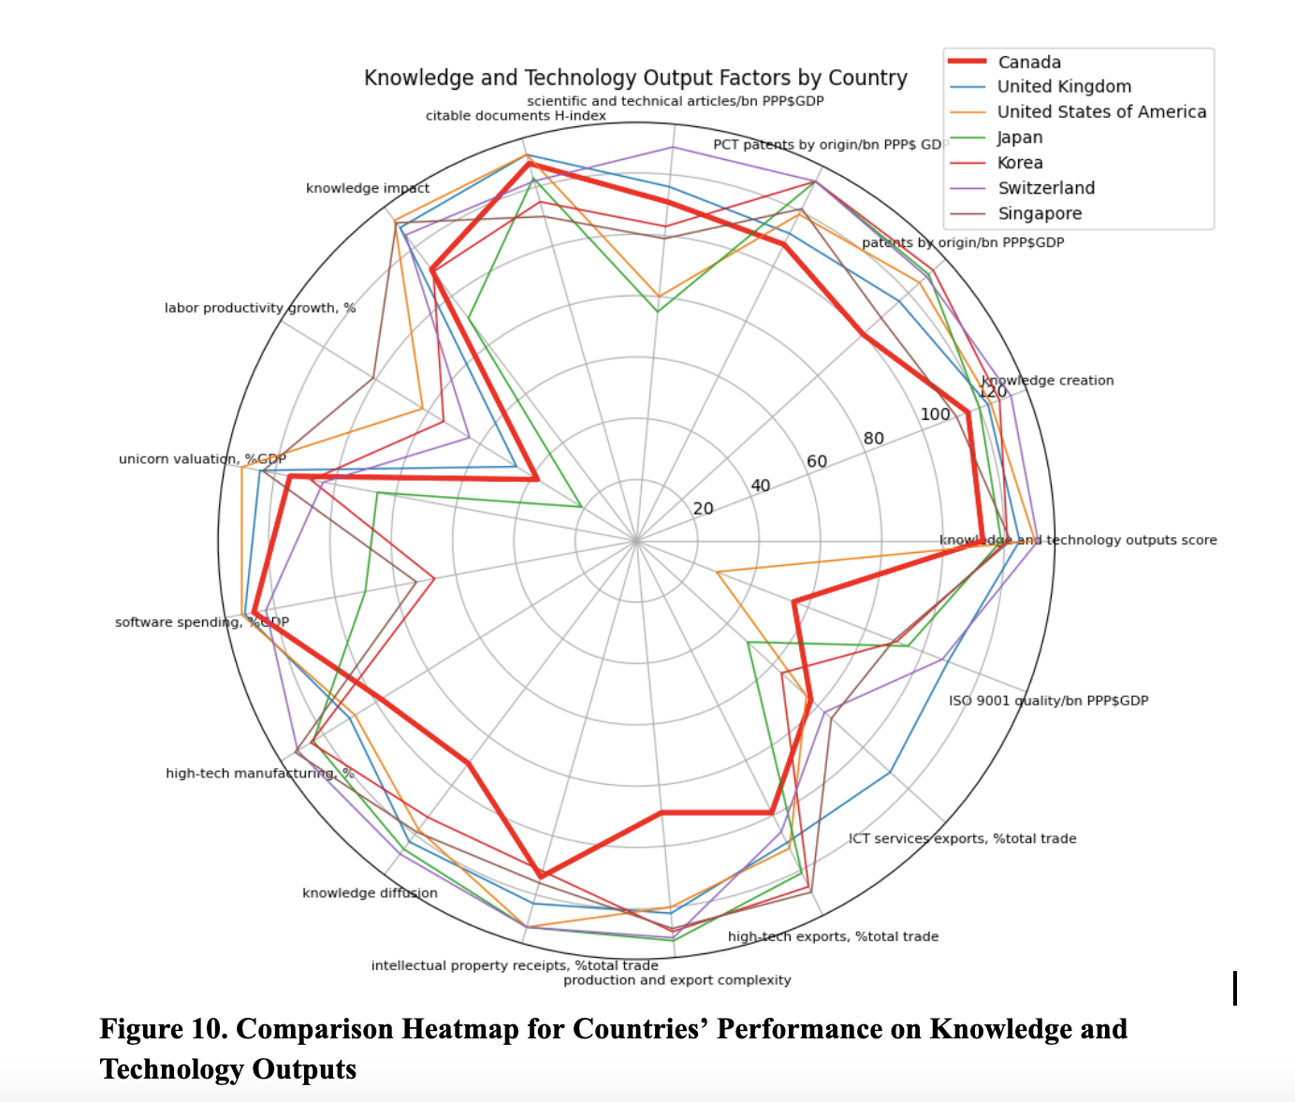
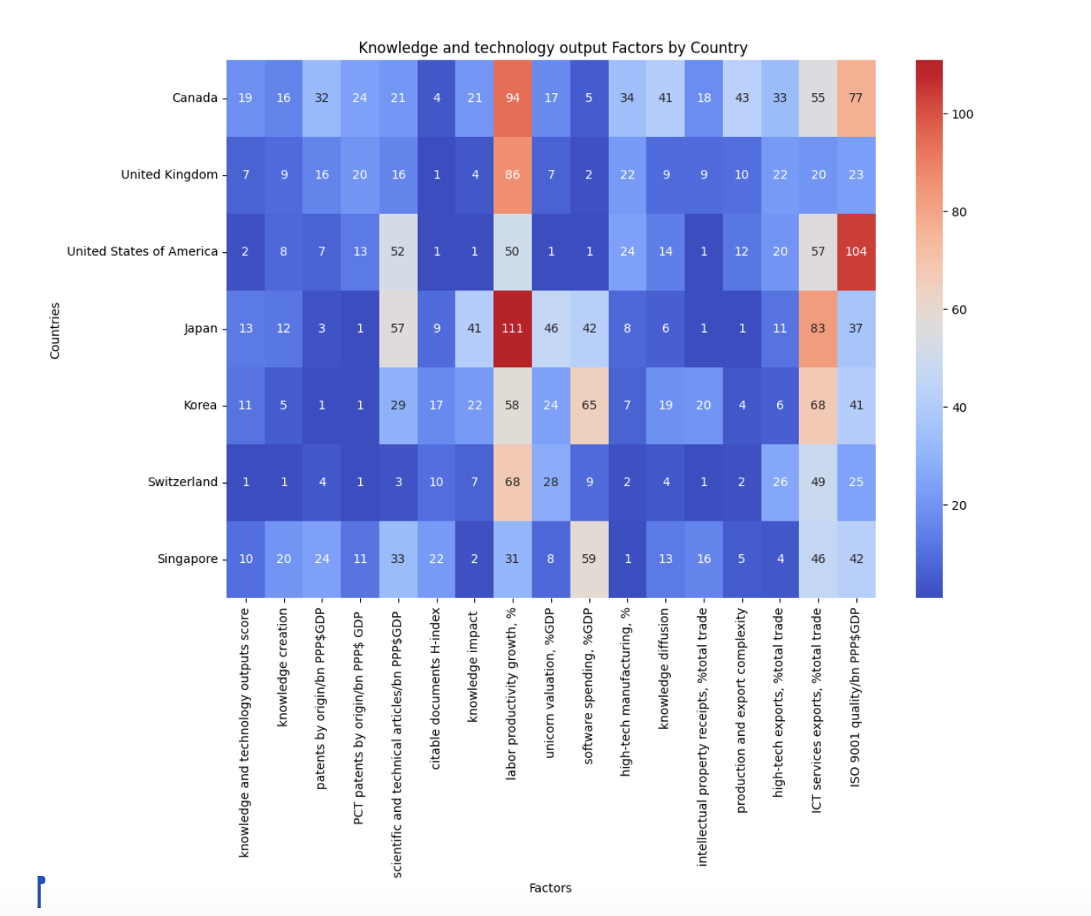
Knowledge & Technology Outputs Factors

Slide 24
Digital & Industrial Workforce Advancement Strategy
Labor Productivity Growth, %
Exports Complexity
Labor productivity is defined as the amount of real gross domestic produced by an hour of labor. As an economy’s labor productivity grows, it produces more goods and services for the same amount of relative work.
Export complexity represents the level of sophistication and diversity in a country's export basket. It measures the variety of products that a country exports. A higher export complexity indicates that a country is exporting more complex products, which often require advanced technology and skills.

Slide 25
Singapore:
Education and Skill Development:
Singapore places a strong emphasis on education and skill development by investing in skilled and adaptable workforce through education and training programs to enhance productivity.
Collaboration Between Government, Industry, and Academia:
Singapore has successfully fostered collaboration between the government, industry, and academia, such partnerships can facilitate knowledge transfer, research, and development, leading to advancements that drive productivity.

Slide 26
Japan:
Investment in Digital Infrastructure:
Japan has achieved high scores in exports complexity, one reason is it has been deeply focusing on digital transformation, it invests in robust digital infrastructure, including high-speed internet and advanced communication networks.
Promotion of Digital Skills Development:
Japan has made strategic investments in cultivating digital skills within its workforce by implementing targeted upskilling programs to ensure a high level of preparedness for the demands of the digital era.

Slide 27
Canada’s Digital Innovation and Infrastructure Enhancement
Strategies:
Multidisciplinary Team Formation:
Form a team from government, industry, academia, and the private sector
Knowledge Exchange Initiatives:
Facilitate workshops, joint projects, and innovation hubs
Cross-Sectoral Collaboration:
Create dialogue platforms
Prioritizing Internet Expansion:
Ensure universal high-speed internet access.
Invest in Robust Infrastructure:
Upgrade for advanced connectivity and security

Slide 28
Tailored Digital Skills Training for Industry-Specific Needs
Create sector-specific
digital transformation training programs
Forge partnerships with key industries for training alignment
Strategic Collaboration
Industry-Alignment Partnerships
Emerging Technologies
Develop training focused on AI, machine learning, blockchain, and IoT
Continuous Monitoring & Adjustment
Regularly evaluate and adapt training strategies

Slide 29
Thanks!
Do you have any questions?
Group 10 MIE1624

